Slide 1
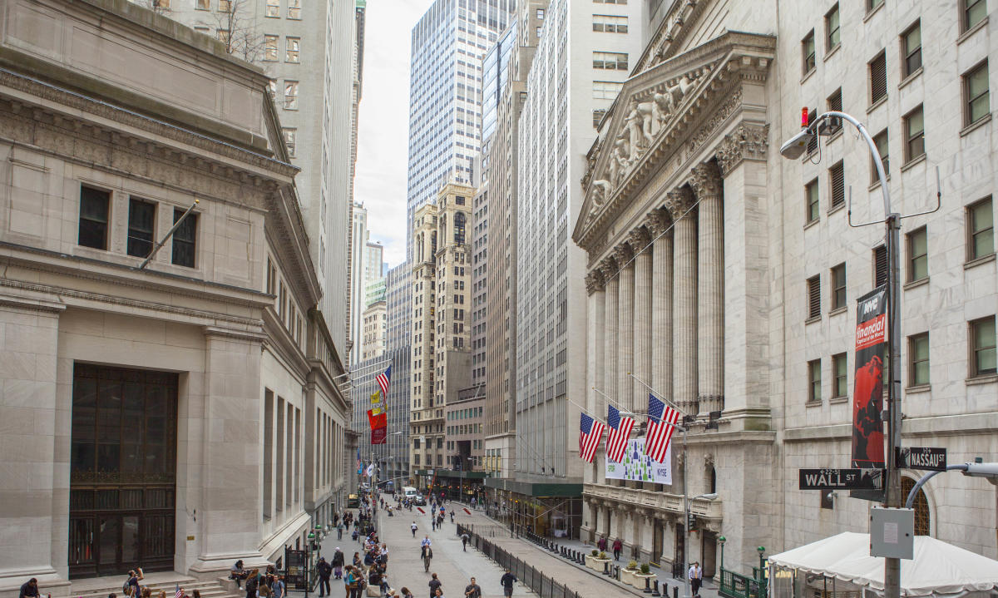
Here is where your presentation begins
Creating an Investment Portfolio

Slide 2
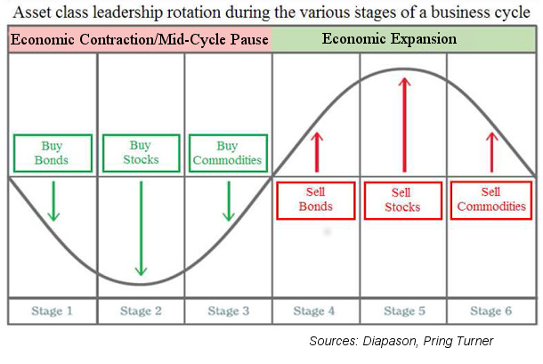
What is an Investment Portfolio?
An Investment portfolio is a group of financial assets owned by an investor.
These assets include equities, fixed income, currencies, real estate etc.
Equities are the most common component of any investment portfolio. Known as risky assets, equities help to grow portfolio value over time.
Fixed income provides investors with “fixed” returns. Compared to other assets, fixed income are known to be less risky.
Currencies help to protect investors from exchange rate risk (hedging). Investors utilise FX contracts when they invest in foreign assets.
Alternative investments (commodities, private equity, real estate) are less liquid compared to previous mentioned assets. Alternative investments tend to lag behind other assets in terms of performance.
Cash is the most important asset in every portfolio. It is safe and most liquid.

Slide 3
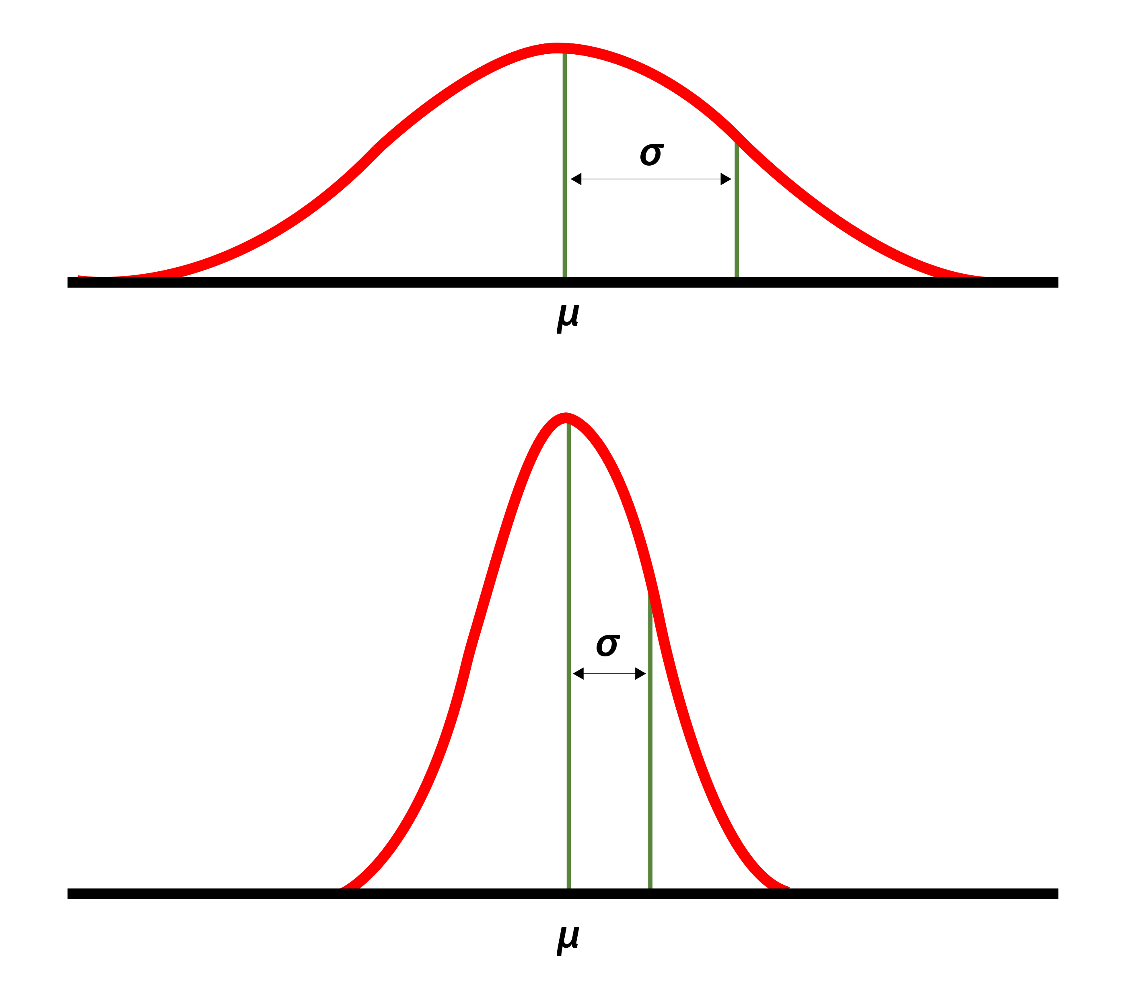
Asset Allocation
Asset allocation refers to an investment strategy that aims to balance risk and return by apportioning a portfolio’s assets according to an investor’s goals.
A common measure of risk is the standard deviation.
Standard deviation (σ) measures the amount of variance of the values relative to its mean.
A high standard deviation means higher risk.
A low standard deviation means lower risk.
Return is normally calculated based on historical returns. Take the average of the historical returns to get your expected return.
Probability
Return
Probability
Return

Slide 4
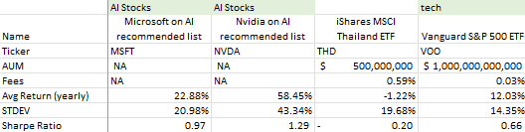
Asset Allocation
Sharpe ratio is a measure of risk-adjusted return.
It measures how much return the you are getting, based on a “unit” or risk you take.
A higher Sharpe ratio is more attractive as it yields better returns relative to the amount of risk.

Slide 5
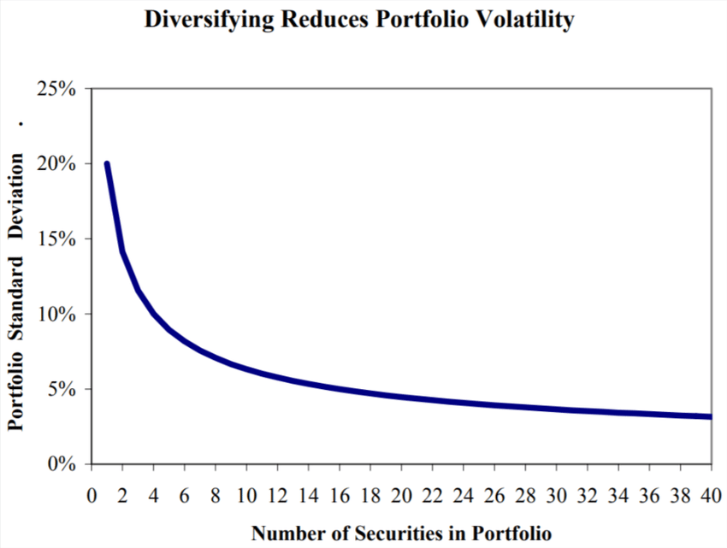
Diversification
Owning a wide variety of investments with different characteristics to reduce volatility.
The basic idea is that by holding a variety of assets, the negative performance of one investment can be offset by the positive performance of another, leading to a more stable and consistent return over time.
Diversification is more effective when the assets are less correlated with one another.
However, diversification do not eliminate risk entirely. Market risk cannot be eliminated using diversification.

Slide 6
Assignment
Assets | Vanguard S&P 500 ETF | iShares MSCI World ETF | iShares MSCI Malaysia ETF | iShares MSCI Japan ETF | SPDR Gold Shares | Invesco QQQ Trust | iShares Russell 2000 ETF | iShares MSCI China ETF
Ticker | VOO | URTH | EWM | EWJ | GLD | QQQ | IWM | MCHI
Average return | 13.68% | 10.61% | -3.59% | 4.07% | -4.62% | 22.86% | 7.54% | 10.83%
Standard deviation | 0.185628201 | 0.174758981 | 0.036030855 | 0.154839993 | 0.339543298 | 0.304647755 | 0.170443312 | 0.188707746
VOO
Track the performance of the S&P 500 Index, which represents the 500 largest publicly traded companies in the U.S. by market capitalization. It offers investors exposure to large-cap stocks across various sectors, including technology, healthcare, finance, and consumer goods.
URTH
Track the performance of the MSCI World Index, which includes large- and mid-cap stocks from developed markets around the world. This means URTH offers global exposure to companies from countries like the U.S., Canada, Japan, the UK, and many others.
EWM
Track the performance of the MSCI Malaysia IMI 25/50 Index. This index includes a broad range of Malaysian companies across various sectors, including finance, consumer goods, and technology.
EWJ
Track the performance of the MSCI Japan Index. This index includes large- and mid-cap companies in Japan, providing investors with exposure to the Japanese equity market.
GLD
Track the performance of the price of gold bullion. It is one of the largest and most well-known gold ETFs in the market, allowing investors to gain exposure to gold without the need to physically hold the metal.

Slide 7
Assignment
Assets | Vanguard S&P 500 ETF | iShares MSCI World ETF | iShares MSCI Malaysia ETF | iShares MSCI Japan ETF | SPDR Gold Shares | Invesco QQQ Trust | iShares Russell 2000 ETF | iShares MSCI China ETF
Ticker | VOO | URTH | EWM | EWJ | GLD | QQQ | IWM | MCHI
Average return | 13.68% | 10.61% | -3.59% | 4.07% | -4.62% | 22.86% | 7.54% | 10.83%
Standard deviation | 0.185628201 | 0.174758981 | 0.036030855 | 0.154839993 | 0.339543298 | 0.304647755 | 0.170443312 | 0.188707746
QQQ
Tracks the performance of the NASDAQ-100 Index, which includes 100 of the largest non-financial companies listed on the NASDAQ Stock Market. This ETF is known for its heavy weighting in technology stocks, making it a popular choice for investors looking to gain exposure to the tech sector.
IWM
Track the performance of the Russell 2000 Index, which measures the performance of the 2,000 smallest stocks in the Russell 3000 Index. This index represents a significant segment of the U.S. small-cap equity market.
MCHI
- Track the performance of the MSCI China Index, which includes large- and mid-cap companies listed in China. This ETF provides investors with exposure to the Chinese equity market, encompassing various sectors and industries.
Notes:
Difference between Nasdaq 100 and S&P500
It includes only the largest companies listed on NASDAQ, which are generally larger in market capitalization compared to companies in the S&P 500. The NASDAQ-100 is more tech-focused, can experience higher volatility and faster growth during bull markets but may also see sharper declines during downturns.

Slide 8
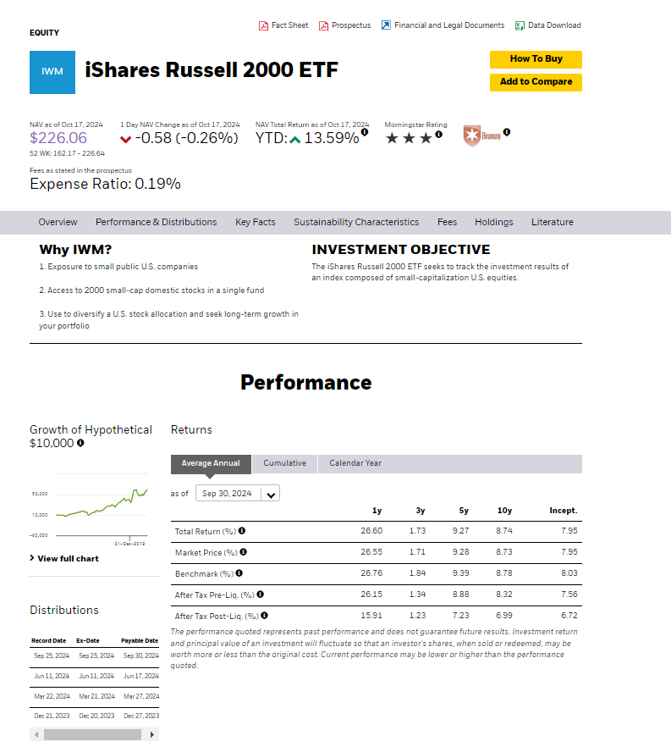
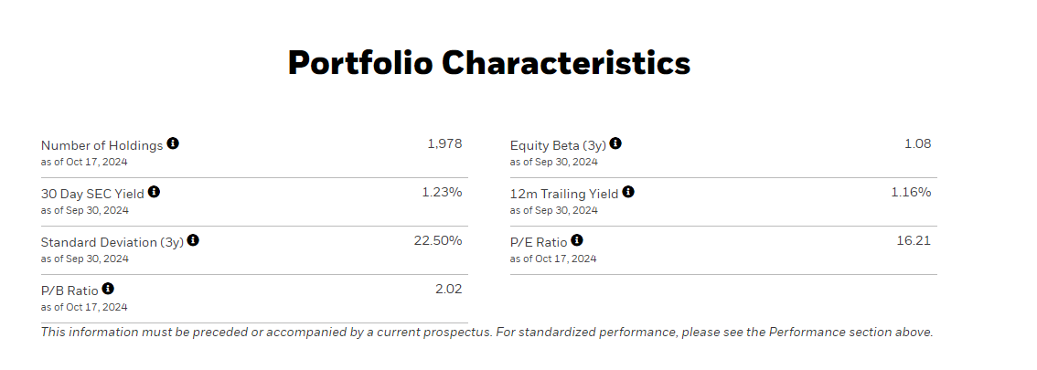
Assignment
Research on each ETF:
Composition – what does the ETF consist of, what does it represent
Market outlook – what are the growth opportunities
Performance (return)
Risk
Sharpe Ratio
Choose 2 assets to form your portfolio
Notes:
Difference between Nasdaq 100 and S&P500
It includes only the largest companies listed on NASDAQ, which are generally larger in market capitalization compared to companies in the S&P 500. The NASDAQ-100 is more tech-focused, can experience higher volatility and faster growth during bull markets but may also see sharper declines during downturns.

Slide 9
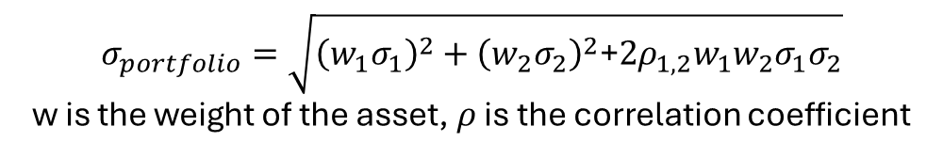
Assignment
Calculate the 2-asset portfolio expected return, portfolio standard deviation, and the Sharpe ratio.
$$r_{portflio}=w_{asset 1}r_{asset 1}+w_{asset 2}r_{asset 2}$$
$$σ_{portfolio}=\sqrt{{\left(w_{1}σ_{1}\right)}^{2}+{\left(w_{2}σ_{2}\right)}^{2}\text{+}2ρ_{1,2}w_{1}w_{2}σ_{1}σ_{2}}$$
w is the weight of the asset, $ρ$ is the correlation coefficient
correlation coefficient | VOO | URTH | EWM | EWJ | GLD | QQQ | IWM | MCHI
VOO |  | 0.99553 | 0.34037 | 0.87450 | 0.79774 | 0.90216 | 0.96310 | 0.17487
URTH |  |  | 0.39156 | 0.91160 | 0.78631 | 0.91425 | 0.97442 | 0.19792
EWM |  |  |  | 0.66151 | 0.56068 | 0.58521 | 0.57883 | 0.37893
EWJ |  |  |  |  | 0.78783 | 0.94328 | 0.94355 | 0.16794
GLD |  |  |  |  |  | 0.90665 | 0.83840 | -0.13888
QQQ |  |  |  |  |  |  | 0.93743 | 0.00868
IWM |  |  |  |  |  |  |  | 0.28452
Present your findings, and your final investment portfolio

Slide 10
Submission Criteria
Deadline: 5th November 2359
Submit Format: PowerPoint Presentation in PDF format
“IA_Group_XX_Assignment1” – XX is your group number
Submit to Cluster Director (email will be shared in telegram group chat)
Ask your Cluster Director if you have any questions!

